Slide 1
Week-02 Requirement Engineering for Web Applications
Course Instructors:
Haris Ahmed
SIR SYED UNIVERSITY OF ENGINEERING & TECHNOLOGY

Slide 2
AGENDA
What is Requirement Engineering?
Fundamentals of Requirement Engineering
Requirement Engineering activities
Principles of Requirement Engineering
Challenges of Stakeholders

Slide 3
WHAT IS A REQUIREMENT?
IEEE Std. 610.12 defines a requirement as
1. An ability needed by a user to solve a problem or achieve an objective;
2. A condition that must be met to satisfy a contract and standard;
3. A documented representation of a capability or condition as in the above two points.
Requirements are basically of the following two types:
1. Functional requirements; and
2. Non-functional requirements.
All these requirements that have been gathered are summarized in the SRS document. This document acts as a contract between the developer and the customer.

Slide 4
WHERE DO REQUIREMENTS ORIGINATE FROM?
Customer themselves do not have a clear idea of what they actually need. They have limited technical knowledge. The following points must be kept in mind:
1. Identify the stakeholders
2. Recognizing multiple viewpoints
3. Working towards collaboration
4. Asking the questions

Slide 5
Requirement engineering-Definition
The process of analyzing, documenting and validating the requirements of the software is known as requirements engineering (RE).
The basic goal of requirements phase in SDLC is to produce software requirements specification (SRS) document as an output or a deliverable. The process of developing this document is called requirements engineering.
According to Davis, requirements engineering is the organized use of principles, techniques, tools and languages for the cost-effective analysis, documentation and changing user needs.

Slide 6
Results of poor re
Some of the major bottlenecks faced in the previous years due to poor RE are as follows:
1. As per the survey report of European Software Institute (ESI) in, more than half of the companies under survey specified poor requirements engineering as a major problem.
2. In another survey conducted on 340 companies in Austria in, more than two-thirds of these companies considered the RE as a major problem.
3. According to the Standish group report in , when 8000 projects were studied, it was found that 30% of the projects failed before their completion date and the remaining 70% projects did not even meet the user’s needs. The reason for this was again poor RE.
4. Then, in another survey on Web projects conducted by the Cutter Consortium Group, it was reported that only 16% of the Web systems met the customer’s requirements and 53% of the deployed systems did not satisfy the required capabilities.

Slide 7
Note that:
1. As we have studied in software engineering that waterfall model requires all requirements to be gathered at the start of the project. But, this is practically not possible as the customer’s requirements keep creeping in as the project progresses. Also, waterfall model is very much unrealistic for Web projects, in particular.
2. The RE methods are used with iterative and agile life approaches.
3. The current RE methods require identification of all sorts of stakeholders, scenario-based discovery of requirements, organizational analysis and clear requirements of all types (Boehm, 2000).

Slide 8
Wireframing in Web Applications
Wireframing
A wireframe is a simple visual layout of a web page. It shows the basic structure of the page without colors, images, or detailed design.
Wireframes usually include:
Header
Navigation menu
Content sections
Buttons
Footer

Slide 9
Purpose of Wireframing
Wireframing is used to create a basic visual structure of a website or web application before the actual design and development begin. It focuses on the layout, placement of elements, and overall structure rather than colors or detailed graphics.
To plan the page layout
To show where elements will be placed
To make early changes easily
To help the team understand the structure

Slide 10
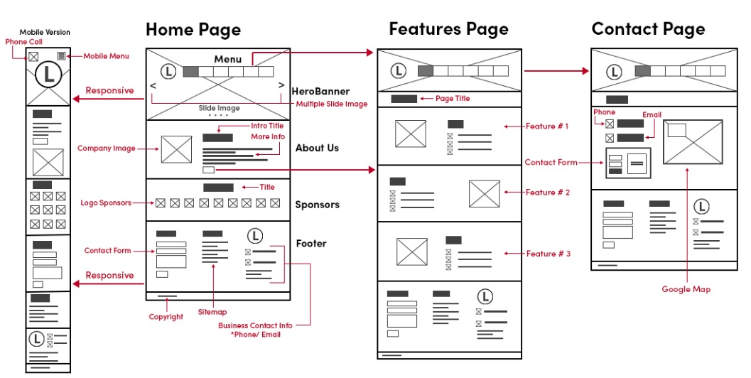
Wireframing in Web Applications

Slide 11
Prototyping in Web Applications
Prototyping
A prototype is a more detailed version of the design that shows how the web application will work.
Unlike wireframes, prototypes may include:
Basic design
Navigation between pages
Buttons that can be clicked
Simulated user interaction

Slide 12
Purposes of Prototyping
Testing User Experience (UX) Prototypes allow designers and users to interact with the system and check if the flow and functionality are intuitive.
Validating Design Ideas It helps verify whether features, layout, and navigation meet user needs and project goals.
Collecting Feedback Early Stakeholders and users can test the prototype and provide feedback before the expensive development phase.
Reducing Development Risks By identifying design flaws or usability issues early, prototypes save time and cost during full development.
Demonstrating Functionality It shows how the system behaves, including buttons, menus, forms, and interactions, which wireframes cannot show.

Slide 13
Requirement Change Management in Web Applications
Requirement Change Management (RCM) is a process used in software and web development to handle changes in the requirements of a project in a controlled and organized way.
What is Requirement Change Management?
Requirement Change Management ensures that any modification in the project requirements is:
Documented
Reviewed
Approved or rejected
Communicated to the development team
This helps prevent confusion, delays, or errors during development.

Slide 14
Why Requirement Changes Happen
Changes in requirements are common in web applications due to:
New business needs – Client may want extra features
User feedback – Users suggest improvements
Technology updates – New tools or frameworks may be used
Error correction – Fixing incomplete or incorrect requirements

Slide 15
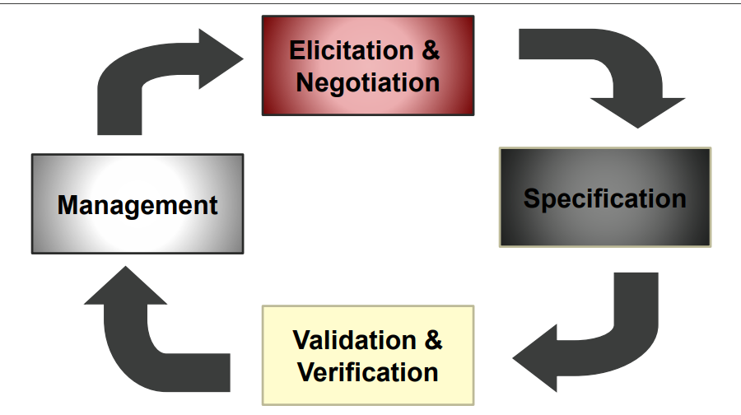
The Requirements Collection Process

Slide 16
ELICITATION & NEGOTIATION
Identify and involve (if possible) the stakeholders
– Those that directly influence the requirements
– Customers, users, developers
What are their expectations?
– May be misaligned or in conflict.
– May be too narrowly focused or unrealistic.
Why is the web application being developed in the first place?

Slide 17
ELICITATION & NEGOTIATION
Elicitation of information about a project may be done by the following two methods:
1. Joint application design (JAD): It aims at building consensus among the developers, the users and the clients by jointly developing the SRS. It is a requirements gathering technique developed at IBM in 1970s. JAD suggests that elicitation of requirements is done in one single workshop session in which all stakeholders participate. The users, clients, developers and a leader sit together in one room to present their viewpoints, negotiate and come to mutually acceptable solution. The final deliverable is a JAD document, including definitions of data elements, workflows and interface screens.
Note that the final JAD document acts as an agreement among developers, users, clients and thus, minimizes requirements changes later in the development process.

Slide 18
So, the main actors involved in the JAD are as follows:
(a) Customer;
(b) Sponsor (top management person);
(c) Facilitator (or project leader);
(d) Scribe (or record keeper); and
(e) System analyst.
In the JAD, held weekly meetings are for 2 to 4 hours. The JAD is useful for larger projects. It involves the following main activities:
(a) Project definition: It includes fact finding and information gathering.
(b) Forming JAD teams: A JAD team is formed by a facilitator and the sponsor.
(c) Kick-off meeting: Initial meeting is started by the sponsor. It focuses on ensuring that all team members understand what JAD is.
(d) Regular JAD sessions: Based on user’s availability, JAD sessions are held for discussion on planning, analysis, design and development.
(e) Traceability: It focuses on recording, structuring, linking, grouping and maintaining dependencies among requirements, and between requirements and other work products.

Slide 19
Contd…
2. Maintaining traceability: Traceability is the ease with which you can traverse between different phases. It includes tracing where the requirements came from and the project they affect. Traceability enables the developers to show that the system is fully developed and the testers to show that the system satisfies their requirements. The approach used cross-references among the documents, models and the codes. Each individual element like requirement, component, class, operation, test case, etc. is identified by a unique number. Then, dependencies are documented manually. For large project, specialized database tools enable partial automation of capture, editing and linking of traceability dependencies at a more detailed level.

Slide 20
REQUIREMENTS Specification
The results of the requirements elicitation and analysis activities are documented in the requirements analysis document (RAD). This document serves as a contract between the client and the developer, and it describes the system in terms of functional and non-functional requirements.
The audience for the RAD includes:
1. Clients;
2. Project management;
3. Users;
4. System analysts; and
5. System designers.

Slide 21
CONTD…
The first part of the document includes use cases and nonfunctional requirements, whereas the formalization of the specification in terms of object models is written during analysis. This RAD should be written after the use case model is stable, i.e., when the number of modifications to the requirements is optimal. Suitable degree of preciseness and formality is decided depending on the types of identified risks and the skills and experience of the expected readers.
As far as the Web engineering is concerned, informal descriptions like user stories and semi-formal descriptions like use cases are quite useful.

Slide 22
VALIDATION
This step is essential to verify that requirements specification corresponds to user’s needs and customer’s requirements
Iterative feedback from stakeholders is essential
– Is the requirement feasible?
– Do the results meet stakeholders’ expectations?

Slide 23
REQUIREMENTS MANAGEMENT
Rather than being stable, requirements are subject to frequent changes. Continuous changes of requirements and constraints are a major characteristic of web projects.
Methods and tools for requirements management support both the integration of new requirements and changes to existing requirements.

Slide 24
EXAMPLE- Requirement Analysis
Revision and formalization of the collected requirements, producing in output a set of semiformal specifications, typically in terms of:
Group specification
Use-case specification
Data dictionary specification
Site view specification
Style guidelines specification
Acceptance tests specification

Slide 25
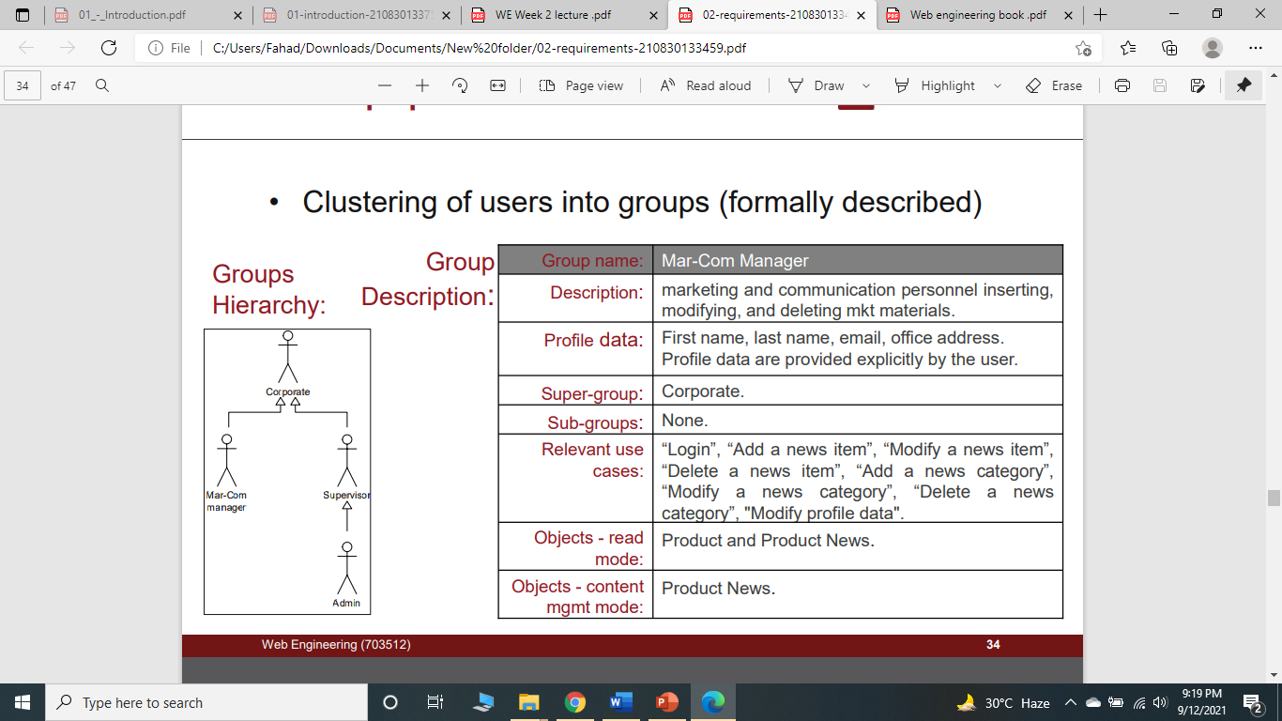
I. Group specification
Clustering of users into groups (formally described)

Slide 26
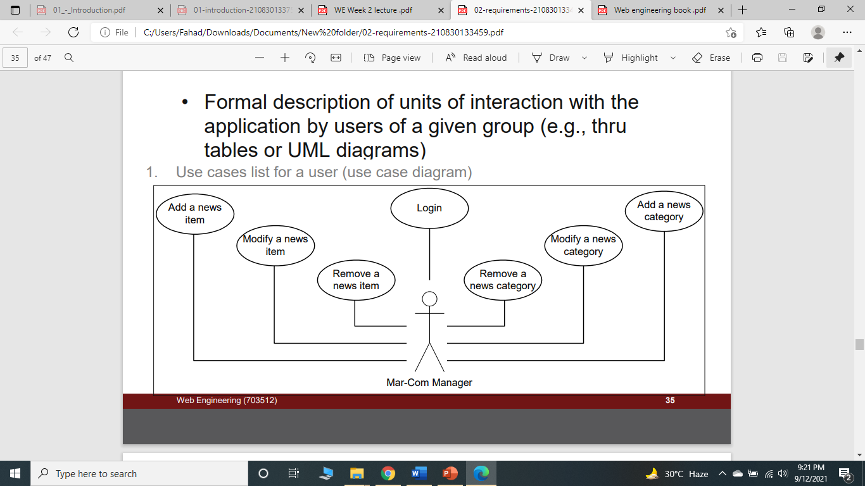
II. Use-case specification
Formal description of units of interaction with the application by users of a given group (e.g., thru tables or UML diagrams)

Slide 27
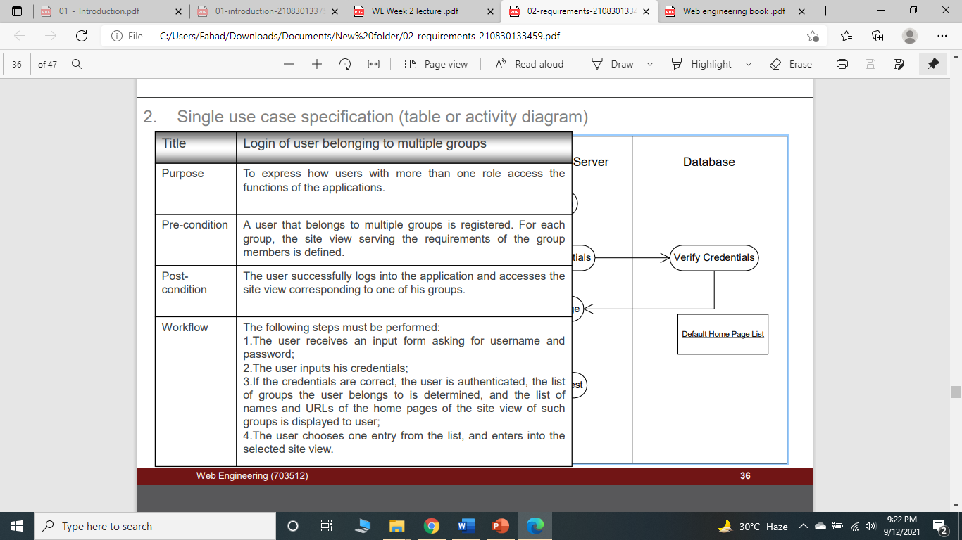
II. Use-case specification

Slide 28
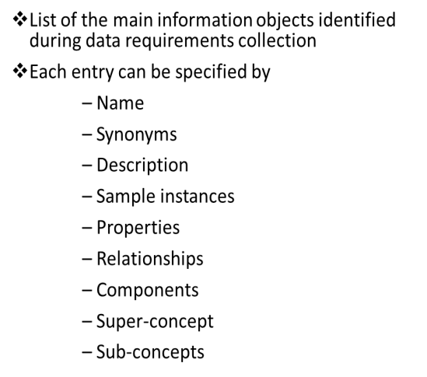
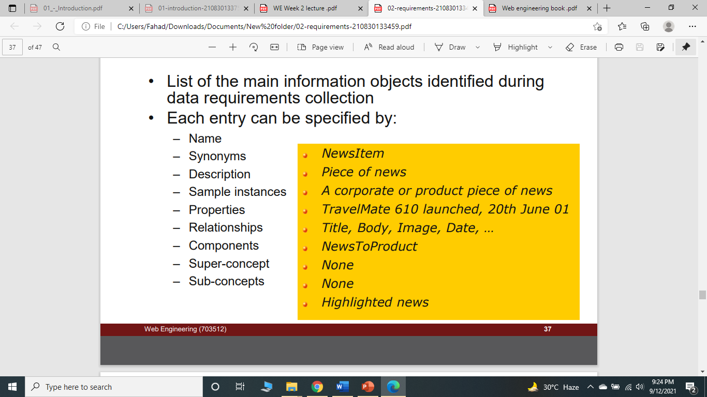
III. Data dictionary specification

Slide 29
IV. Style guidelines specification
Rules for the presentation of pages:
Specification of standard page grids: rows, columns and cells arrangement
Content positioning specification: banners, logo, menus positioning
Graphical guidelines: rules for graphic items like fonts, colors, borders and margins
Device-specific and browser-specific guidelines
Example: Mock-ups: sample representations of a few typical application pages (for a specific device and rendition language)

Slide 30
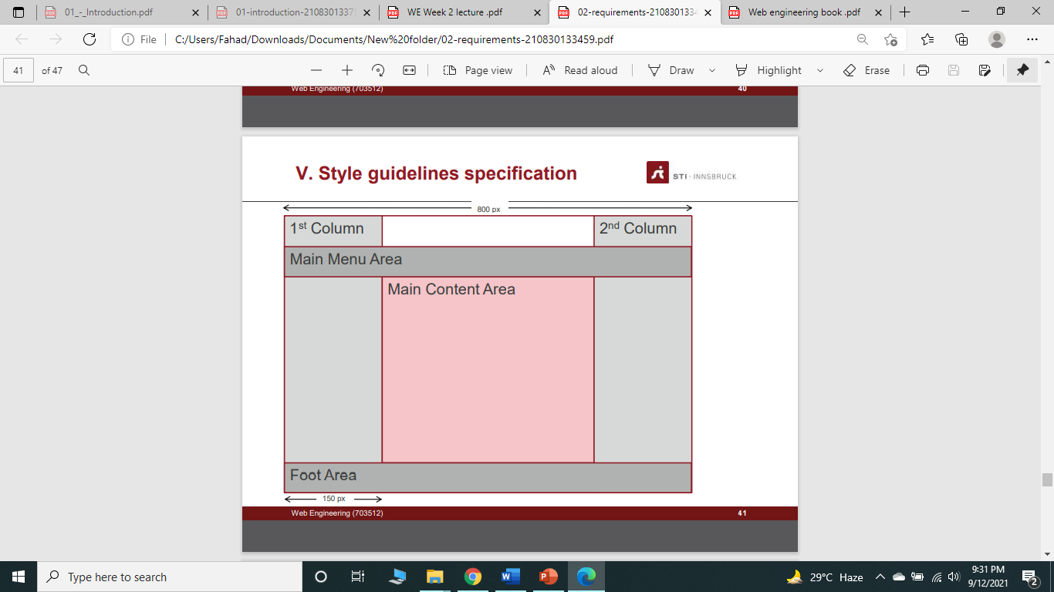
IV. Style guidelines specification

Slide 31
RE Specifics in Web Engineering
Is RE for the Web really that different than RE for conventional software?
Top 6 distinguishing characteristics
1) Multidisciplinary teams
2) Unavailability of stakeholders
3) Rapidly changing requirements & constraints
4) Unpredictable operational environment
5) No manual for the user interface
6) Content Management

Slide 32
ADAPTING RE METHODS TO WEB APPLICATION DEVELOPMENT
For Web engineering projects, the requirements may be of the following types:
1. Web functional requirements
2. Contents requirements
3. Quality requirements/Non-functional requirements
4. Environment of system-based requirements
5. GUI-related requirements
6. Evolution requirements
7. Constraints on the project

Slide 33
summary
Know your Audience & Objectives
– Balancing stakeholder interests
– Focus on high-level requirements first.
Elicitation & Negotiation is a learning process
RE requires flexibility
– Iterative changes should be expected
– Be sure stakeholders understand this!
Clear documentation is critical

Slide 34
Discussion
What are requirements scrubbing?
Specify some requirements engineering tools.
“The more complex is the Web site code, the easier is to hack a Web site”. Explain.

